Slide 1
A Parent’s Guide
to Ms. Davis’s K-6 General and Vocal Music Program

Slide 2
Contents
Click the arrow to go to section
About the Guide
Developing Musicianship
Music Potential
Strategies and Resources
How Children Learn Music
Credits and Citations

Slide 3
About the Guide
The purpose of this guide is to inform parents on their child’s potential to learn music, the neuroscience that explains this potential and its benefits across the wider curriculum, and the development of student musicianship.
I will discuss these topics under the lens of my K-6 general and vocal music program; therefore, only these ages will be discussed.
At any time, you may click the grand piano in the right-hand corner to be taken back to the table of contents.

Slide 4
Music Potential
All children have the potential to learn music. Musical intelligence is part of the seven multiple intelligences identified by Dr. Howard Gardener, a celebrated past professor of education at Harvard University. The musical intelligence, according to Gardener, is “the ability to produce and appreciate rhythm, pitch, and timber” (Northern Illinois University, 2015, p. 1). People have different strengths and preferences of intelligences, but the potential for each to develop through experience and instruction is ever-present.
As a music teacher, it is my job to develop your child’s musical intelligence to the fullest potential of their individual ability and aptitude.

Slide 5
How Children Learn Music
Children have musical experiences at home, at school, in the community, and through media. By the time they are in 5th-6th grade, whether they had formal music training or not, they are competent music listeners, often identifying themselves and others around them by the kind of music they listen to (Ilari, 2013).
As stated in the previous slide, all children are born with a certain degree of musical aptitude. Beatriz Ilari, an Assistant Professor of Music Education at USC, takes this further. “We start off as sophisticated musical beings,” she says in her 2013 TedTalk video. “Babies come into this world well-equipped to listen to a wide range of musical sounds” (Ilari, 2013). Through playing musical games, singing tunes, and listening to music learned from a wide range of contexts, children are practicing and developing musical skills without even knowing it.
Notes:
Picture retrieved from: http://thenextfamily.com/2013/06/what-would-you-do-if-another-child-stole-your-kids-drum/

Slide 6
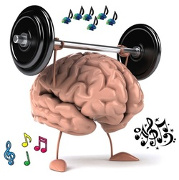
How Children Learn Music (con’t)
However, studies show that children who receive formal music training can find even further benefits to the abilities and function of the brain. Neuroscientists who studied the brains of performing musicians saw nearly every area of the brain light up with activity. Unlike just listening to music, participating in music develops fine motor control skills, linguistic and mathematic centers of the right and left brain, problem solving, social and academic skills, and a host of others (Collins, 2014). So this is where I come in!
This natural music enculturation (music listening) engages many areas of the brain at once. According to the CNN article, “This is Your Brain on Music,” different elements of music listening (lyrics, melody, rhythm) exercise such important centers as the left temporal lobe, right parietal lobe, and the cerebellum (Landau, 2016). These areas are key in the development of many brain functions—auditory, movement, attention, planning, and memory.
Notes:
Picture retrieved from: http://silvastrings.weebly.com/benefits-of-music-education.html

Slide 7
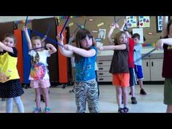
Developing Musicianship
As a music teacher, it is my job to take all of the available research and theories of music development, and create a curriculum that will not only enhance the music enculturation that happens outside school, but also introduce formal music instruction to my students. I have broken down my curriculum for you to show how I accomplish this.
K/1
These early grades are dedicated to creating good musical experiences, developing the ear through tone matching games, and developing both fine motor control and coordination through movement and physical activity.
With these grades, I focus primarily on singing and moving to fun, valuable music; matching pitches and rhythms with games; and using instruments to develop beat.
Lummi sticks are a fun way for my students to keep a steady beat and match rhythms!
Notes:
Picture retrieved from: https://www.pinterest.com/tcmasters/school-rhythm-sticks/

Slide 8
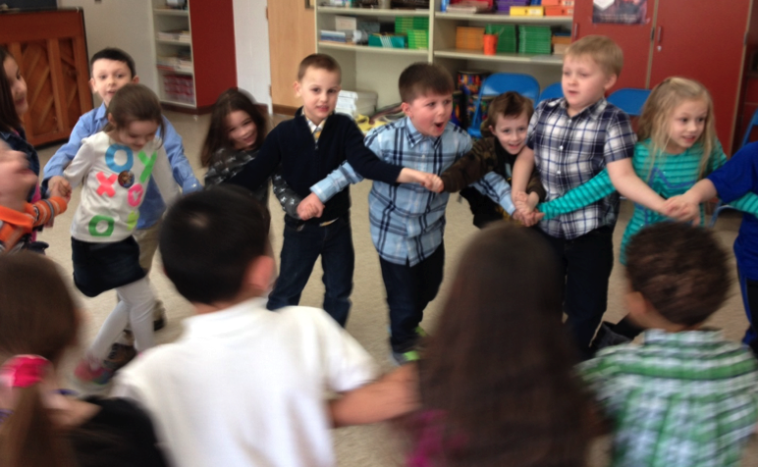
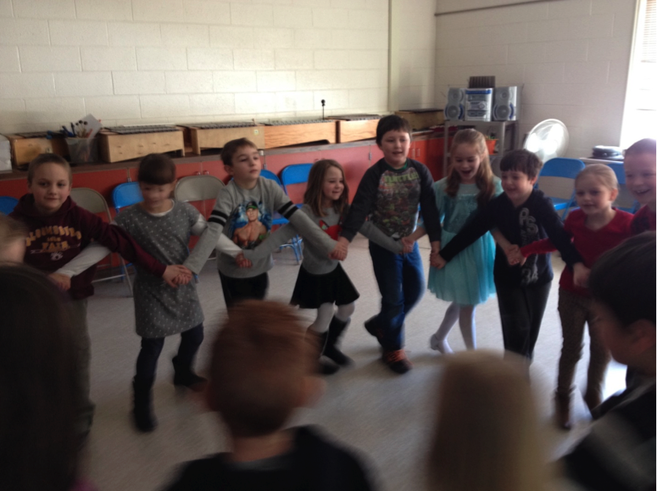
2/3
With maturation and previous experience, seconds and third graders are ready to experiment with progressively more complex tonal and rhythmic patterns. They have acquired the physical control needed to play melodic instruments, such as the xylophone, which helps their exploration of the musical elements. I begin to formally introduce the elements of music that students have been already been developing through musical experiences—tempo, dynamics, meter, range, etc. I continue to add to their musical experiences by studying instruments of the orchestra, expression through body movement, musical creativity/improvisation, and world music culture.
Some of my students enjoying Irish step-dancing!
Notes:
Pictures are from my own camera! GBCSD 2nd graders, April 2015.

Slide 9
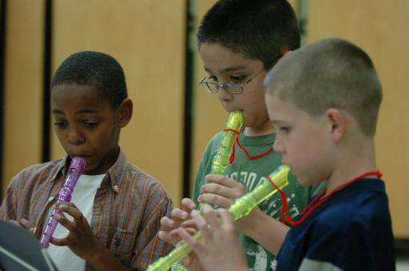
4/5
According to Gardener’s theory of multiple intelligences, the aptitudes settle into what they will be for the rest of the child’s life around this age group. Students are more independent, have a more developed sense of self, and are ready for more abstract thinking (as opposed to the concrete thinking of younger ages.) So this is the age where I introduce music notation vocabulary, using the recorder as a tool to teach/reinforce clef, note values, simple time and key signatures, and other aspects of music literacy. The songs sung in class morph from unison singing to part singing. Music correlates closely with math, social studies, and other subjects to contribute to the overall academic growth of the child.
6
6th graders continue to develop the music fluency skills of the 4th and 5th grade recorder program by singing/performing complex rhythmic and harmonic patterns, completing theory worksheets on treble and bass clef pitch reading, composing and performing original compositions, studying music history and key composers, and listening to/analyzing classical musical forms such as sonatas, concertos, and rondos.
Notes:
Picture retrieved from: http://www.therooster.com/blog/we-found-weirdest-musical-instruments-world-wean-you-your-synth-pad

Slide 10
How can parents help?
According to Gordon’s theory of aptitude, the musical aptitude a child is born with must be maintained, or it will diminish (Cutietta, 1991). Here are some activities/resources you can use with your child to help maintain their musical aptitude!
K-3rd grade: These students must have as many worthwhile musical experiences as they can—I encourage you to listen to quality children’s music from great artists such as Raffi, Hap Palmer, Red Grammar, and Greg & Steve. Have them come up with their own movements to express the words of the songs, and to express themselves!
4th-5th grade: The kids come home with workbooks that have their recorder songs and lesson content in them—encourage your students to practice their recorder for at least 10 minutes a day.
6th grade: Encourage students to go and listen to different kinds of music, to practice their band instruments/choral songs, and attend different concerts/musical events in the community!

Slide 11
Resources
The following are good websites for kids to explore music through interactive games and content:
www.dsokids.com
http://pbskids.org/games/music/ http://www.sfskids.org
http://www.incredibox.com http://www.quavermusic.com
For parents: This is North Country Public Radio’s list of regional music venues—just click on the name of the venue to be taken to that venue’s website, and see what’s going on! Bookmark this page and keep an eye out for good musical experiences to share with your family!
http://ncprmusic.org/regional-music-venues/
http://ncprmusic.org

Slide 12
Citations
Collins, A. (2014, July 22). How playing an instrument benefits your brain [video file]. Retrieved from https://www.youtube.com/watch?v=R0JKCYZ8hng
Cutietta, Robert A.(1991). Edwin Gordon’s impact on the field of music aptitude. The Quarterly, 2 (1-2). Retrieved from http://www.usr.rider.edu .
Howard Gardner’s Theory of Multiple Intelligences. Northern Illinois University, Faculty Development and Instructional Design. www.niu.edu/facdev.
Ilari, B. (2013, March 14). Music & the young brain [video file]. Retrieved from
https://www.youtube.com/watch?v=eLQbqXJF-2M
Landau, E. (2016, February 2). This is your brain on music [video file]. Retrieved from http://www.cnn.com/2013/04/15/health/brain-music-research/#
Thompson, W. F. (2009). Music, thought and feeling: Understanding the psychology
of music. New York: Oxford.

